Slide 1
Modelling metabolic networks with Stan
Teddy Groves

Slide 2

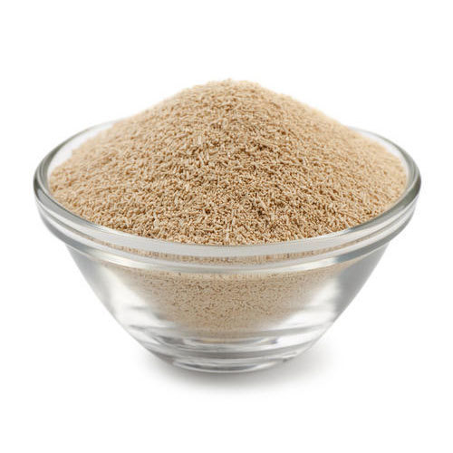
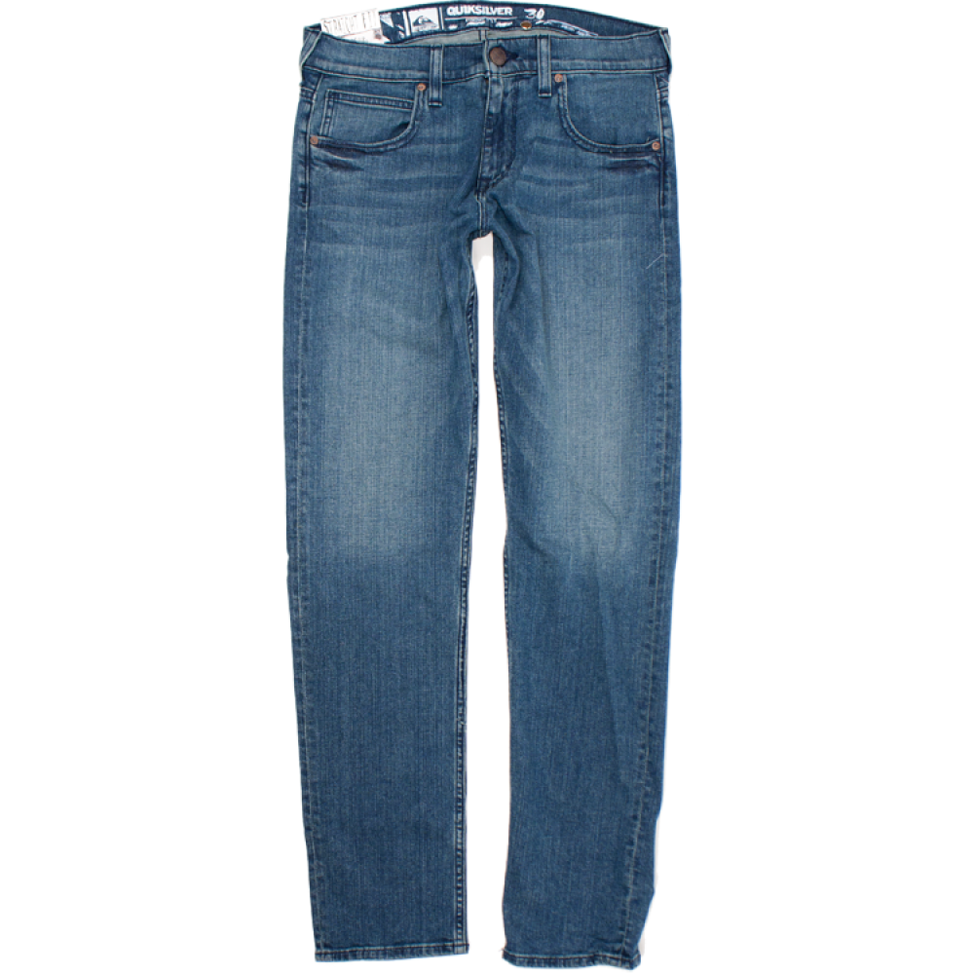
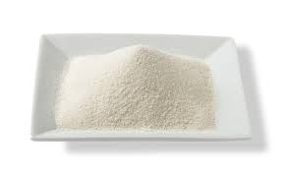

Cell factories
Beer
Indigo
Yeast
Glucose
Spandex

Slide 3
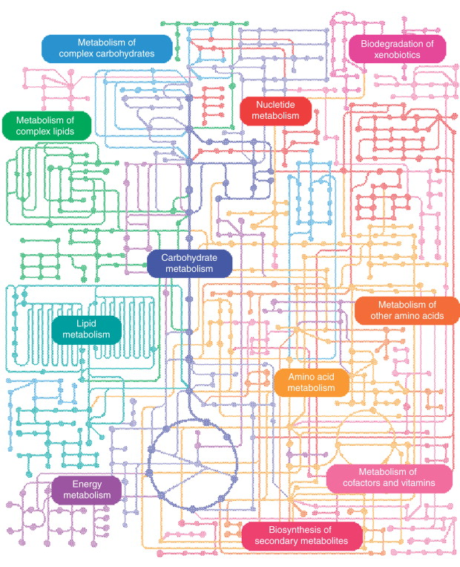
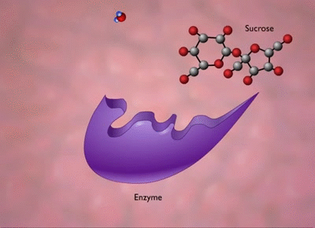
Metabolic networks

Slide 4
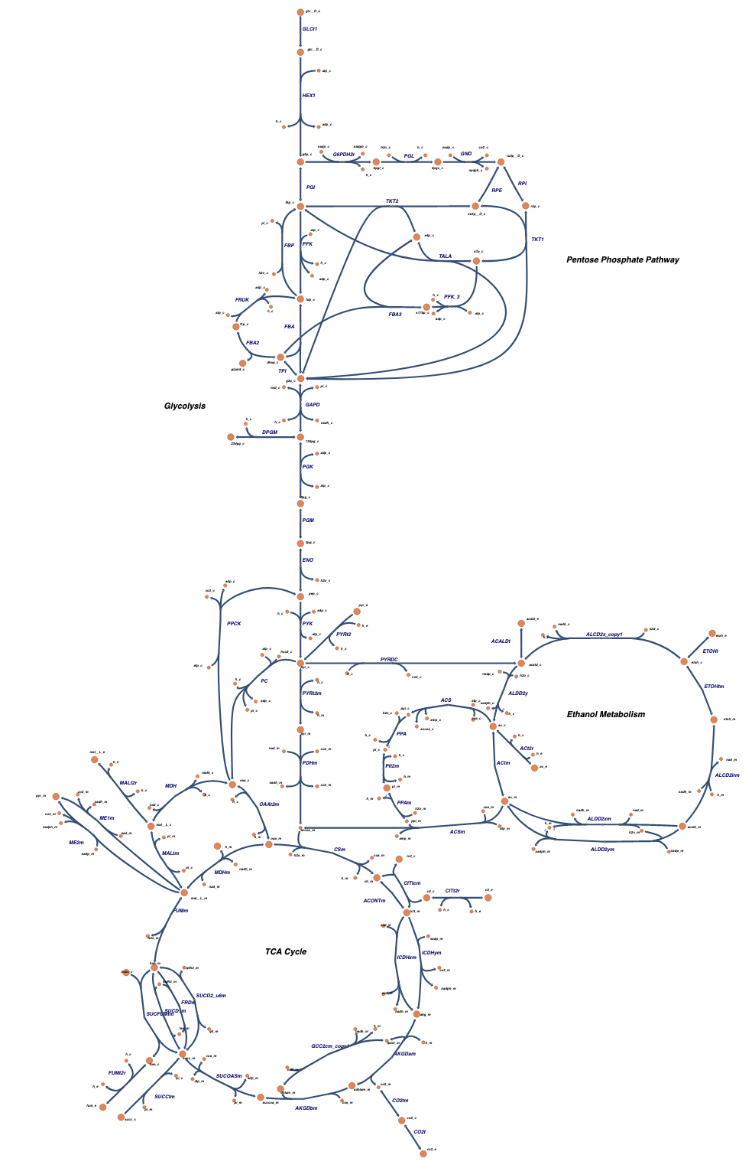
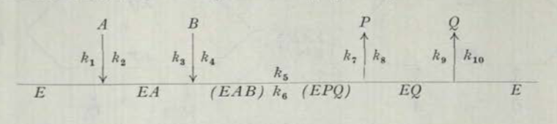
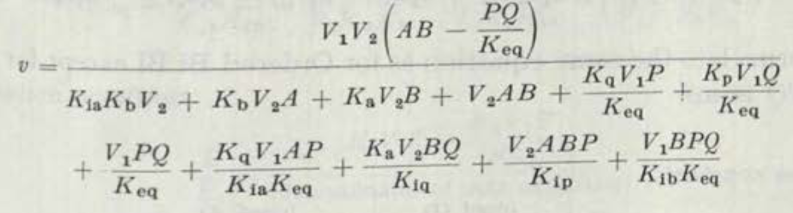
Structural information
Mechanism
Network topology
Rate equation

Slide 5
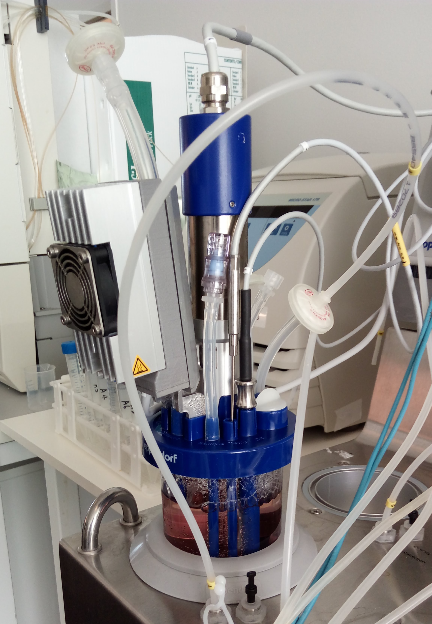
Experimental data
Metabolomics
(metabolite concentrations)
Proteomics
(Enzyme concentrations)
Fluxomics
(Steady state fluxes)

Slide 6
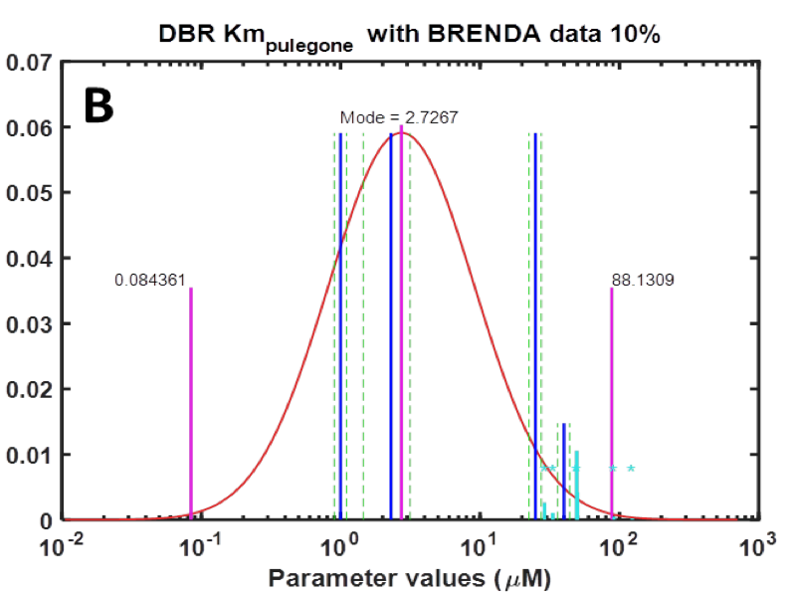


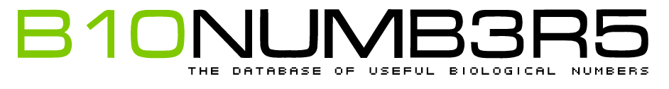
Information from online databases

Slide 7
The plan
Structural information
Information from online databases
Experimental data
Predicted measurements
Knowledge about enzymes’ properties
Understanding weird effects
Statistics

Slide 8
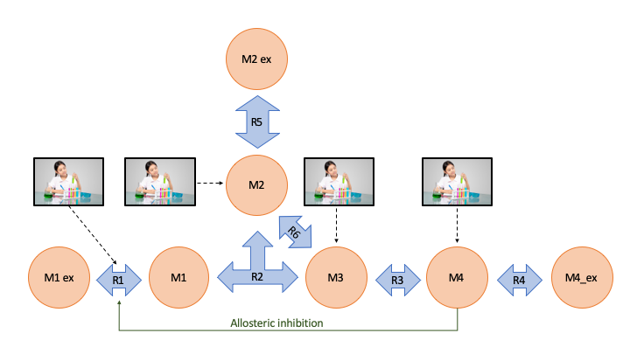
A simple reaction network

Slide 9
Challenges
Some enzymes bind to molecules that change their behaviour (allosteric regulation)
Some parameter configurations imply perpetual motion machines (thermodynamic feasibility)

Slide 10
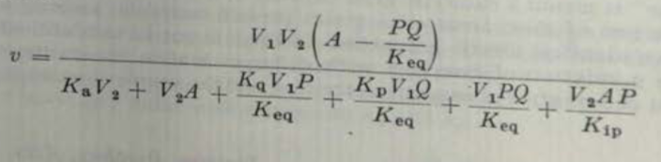
How we represent rate equations
real ordered_unibi(real A, real P, real Q, real V1, real V2, real Ka,
real Kp, real Kq, real Kia, real Kip, real Kiq, real Keq){
real num = V1*V2*(A-P*Q/Keq);
real denom =
Ka*V2
+ V2*A
+ Kq*V1*P/Keq
+ Kp*V1*Q/Keq
+ V1*P*Q/Keq
+ V2*A*P/Kip;
return num / denom;
}

Slide 11
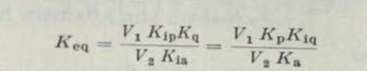
How we represent thermodynamic constraints
real get_Kip_ordered_unibi(real Keq, real Kia, real Kq, real V1, real V2){
return Keq*Kia*V2 / (Kq*V1);
}
real get_Kiq_ordered_unibi(real Keq, real Ka, real Kp, real V1, real V2){
return Keq*V2*Ka / (V1*Kp);
}

Slide 12
How we represent allosteric regulation
real get_regulatory_effect(real[] activator_concentration,
real[] inhibitor_concentration,
real free_enzyme_ratio,
real[] dissociation_constant_r,
real[] dissociation_constant_t,
real transfer_constant){
real Q_num = size(inhibitor_concentration) == 0 ? 1 :
1 + sum(to_vector(inhibitor_concentration) ./ to_vector(dissociation_constant_t));
real Q_denom = size(activator_concentration) == 0 ? 1 :
1 + sum(to_vector(activator_concentration) ./ to_vector(dissociation_constant_r));
real Q = transfer_constant * free_enzyme_ratio * Q_num / Q_denom;
return inv(1 + Q);
}

Slide 13
How we represent network structure
real[] get_odes(real[] fluxes){
return {
1*fluxes[1]-1*fluxes[2],
0,
1*fluxes[2]-1*fluxes[5]-1*fluxes[6],
1*fluxes[2]-1*fluxes[3]+1*fluxes[6],
1*fluxes[3]-1*fluxes[4],
0,
0
};
}

Slide 14
How we determine steady state quantities
transformed parameters {
...
concentration[,e] = integrate_ode_bdf(steady_state_equation,
initial_concentration,
initial_time,
{steady_time},
kinetic_parameter,
known_reals[,e],
known_ints,
rel_tol, abs_tol, max_steps)[1];
flux[,e] = get_fluxes(concentration[,e], kinetic_parameter, known_reals[,e]);
...
}

Slide 15
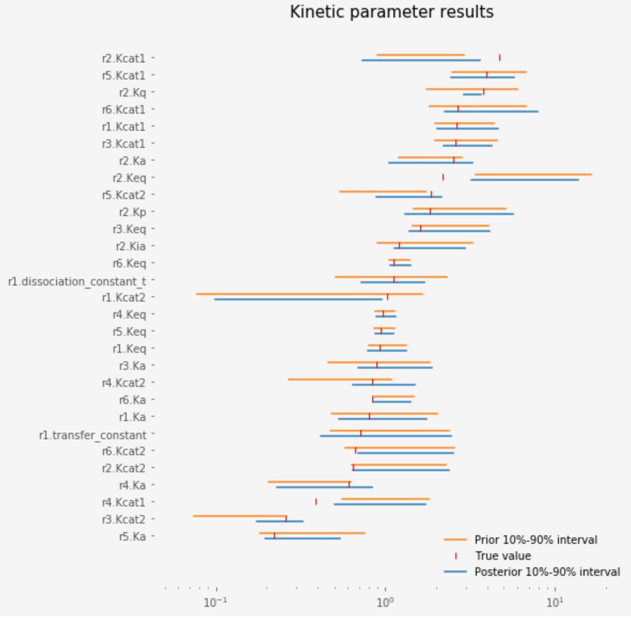
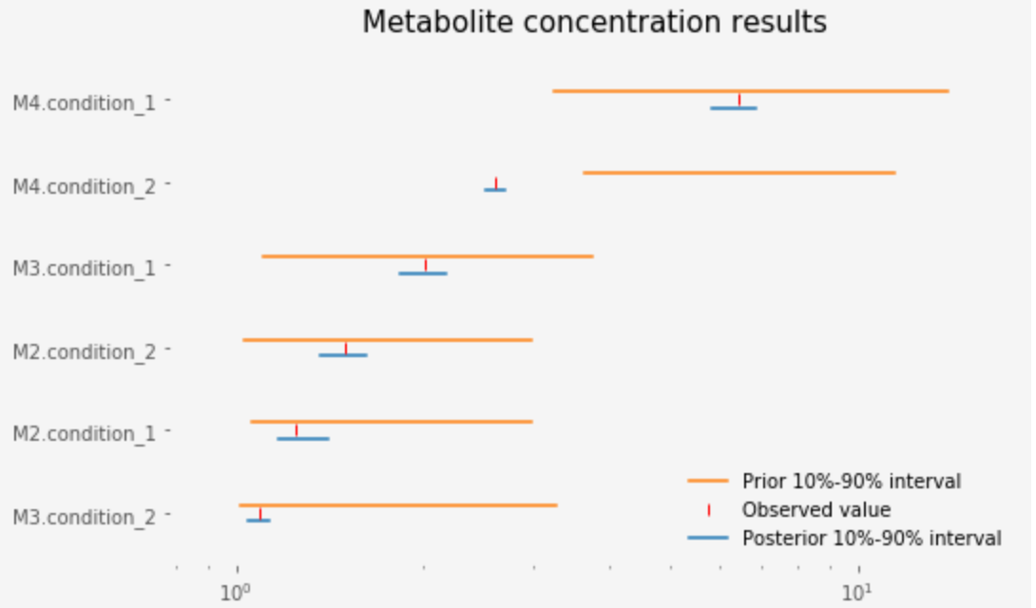
Results

Slide 16
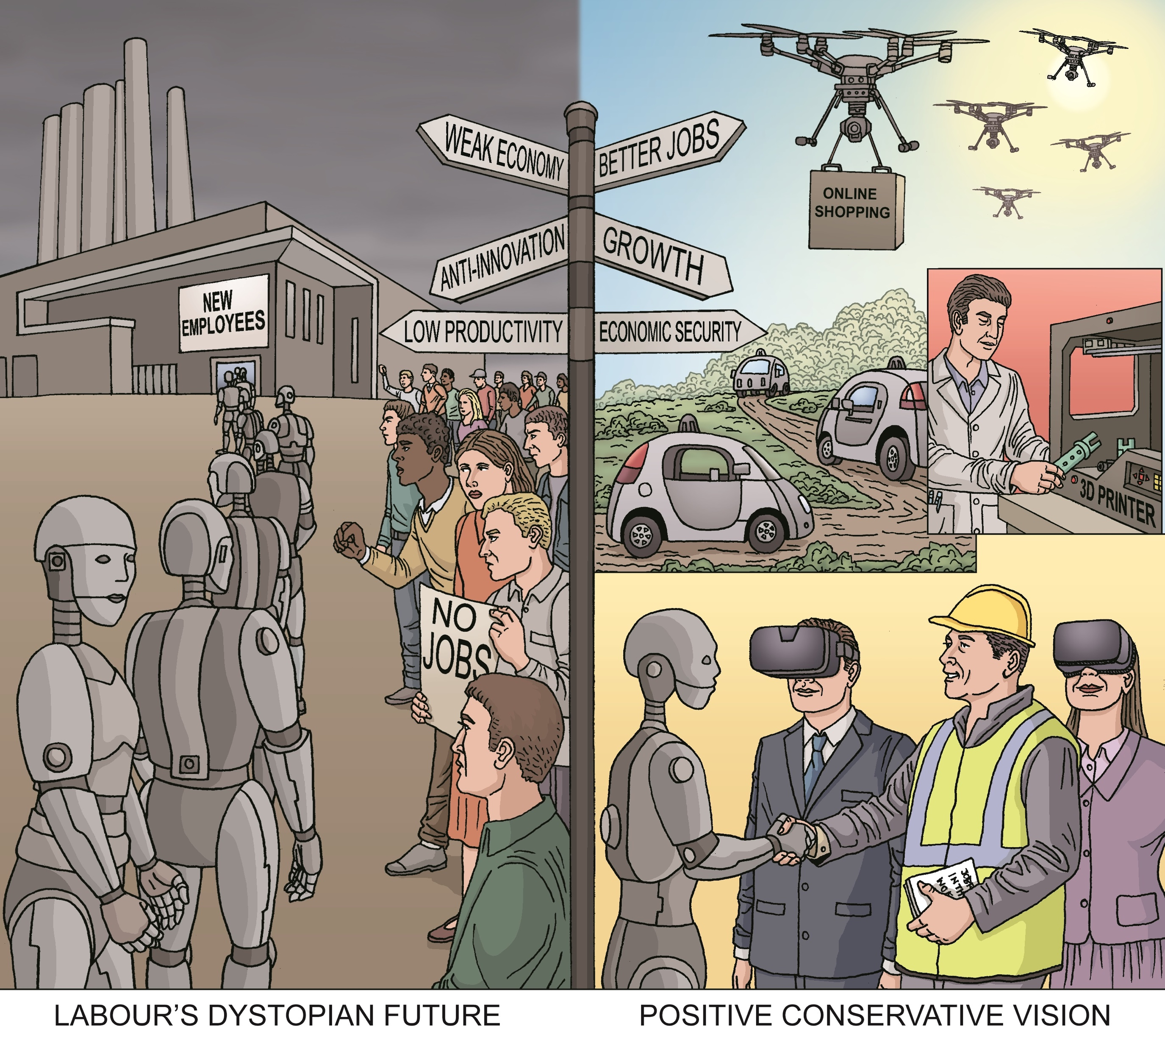
The future
Networks with 50-100 reactions
Support for custom reaction mechanisms
Realistic measurement model
Integration with popular tools
Escher
COBRA
DD-Decaf

Slide 17
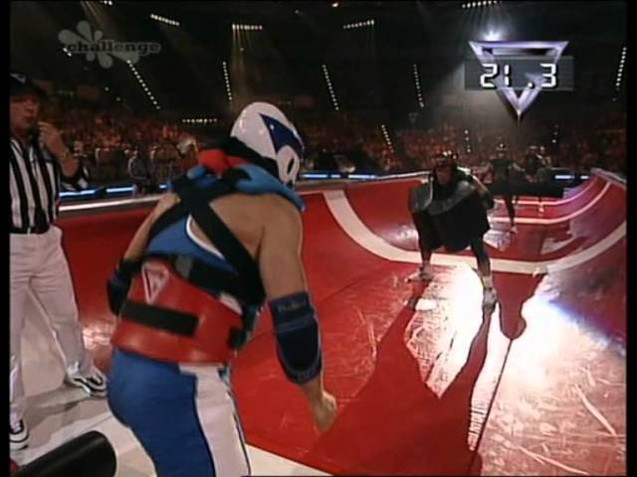
Challenges (please help!)
Is there a better way to solve for steady state?
How to exploit sparse ODE Jacobians?
How to minimise posterior density evaluations?

Slide 18
References
Rate equations
Cleland, W. W. (1963). The kinetics of enzyme-catalyzed reactions with two or more substrates or products: I. Nomenclature and rate equations. Biochimica et Biophysica Acta (BBA) - Specialized Section on Enzymological Subjects, 67(), 104–137. http://dx.doi.org/10.1016/0926-6569(63)90211-63
Enzyme kinetics in general
Saa, P. A., & Nielsen, L. K. (2017). Formulation, construction and analysis of kinetic models of metabolism: A review of modelling frameworks. Biotechnology Advances, 35(8),981–1003. http://dx.doi.org/10.1016/j.biotechadv.2017.09.005
Allosteric regulation
Popova, S. V., & Sel'kov, E. E. (1975). Generalization of the model by monod, wyman and changeux for the case of a reversible monosubstrate reaction. FEBS Letters, 53(3), 269–273. http://dx.doi.org/10.1016/0014-5793(75)80034-2
Saa, P., & Nielsen, L. K. (2015). A General Framework for Thermodynamically Consistent Parameterization and Efficient Sampling of Enzymatic Reactions. PLOS Computational Biology, 11(4),1004195. http://dx.doi.org/10.1371/journal.pcbi.1004195

